Slide 1
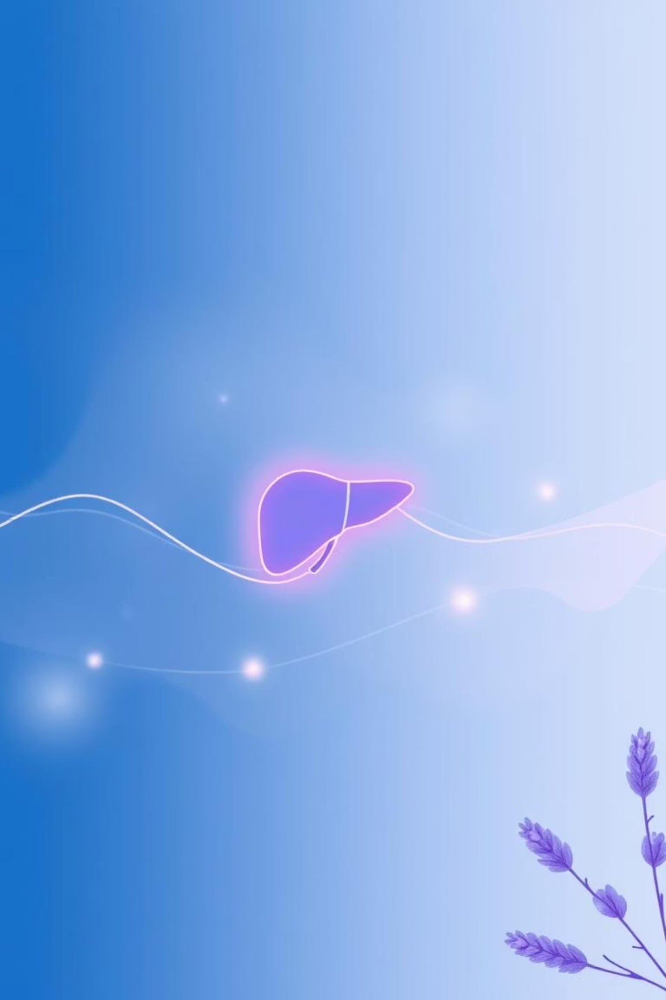
Revolutionizing Liver Care: Predicting Liver Cirrhosis using Advanced Machine Learning Techniques
Team ID: LTVIP2025TMID35238
Team Leader : D. Priyanka
Team member : D. Manideep
Team member : D. Jayanth
Team member : D. Venkata Raghava

Slide 2
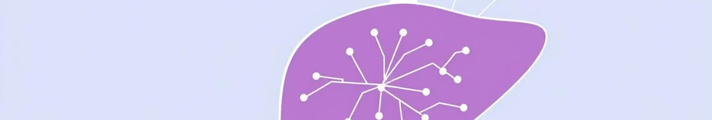
Introduction: Project Overview
This project leverages machine learning to predict liver cirrhosis stages based on 17 clinical parameters. It offers a web interface built with Flask and Tailwind CSS, allowing users to input medical data and receive instant predictions with severity descriptions.
The purpose is to demonstrate ML's practical use in healthcare, aiding early diagnosis and reducing treatment delays through an accessible web tool.

Slide 3
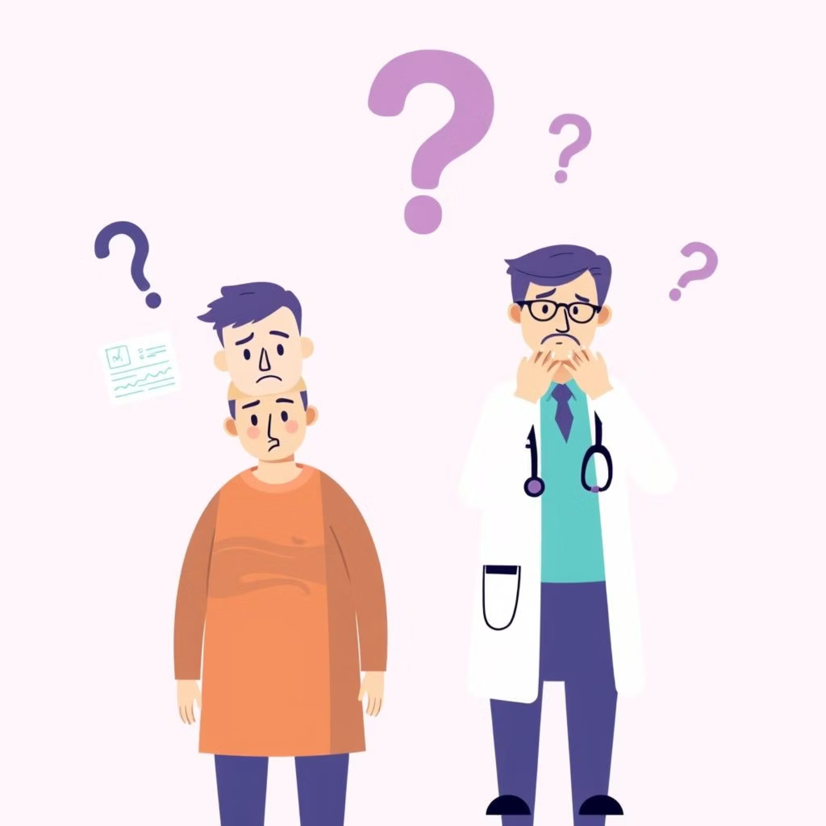
Ideation: Defining the Problem
Patient Perspective
Patients struggle to understand their liver condition early due to expensive and time-consuming advanced tests, leading to anxiety and uncertainty.
Healthcare Professional Perspective
Healthcare professionals face challenges with quick initial assessments due to time-consuming manual evaluations and variable lab data interpretation, causing stress.

Slide 4
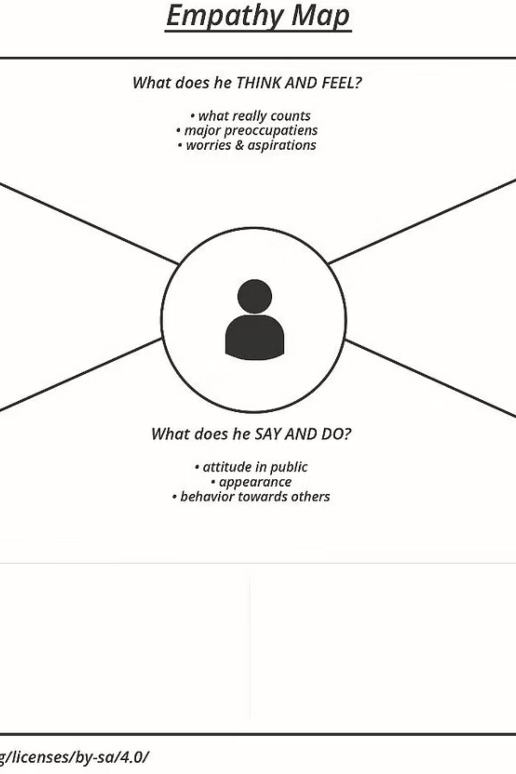



Empathize & Discover: User Needs
Thinks & Feels
Sees
Worries about worsening health, reliability of tests, and fears misdiagnosis or delays.
Confusing lab reports, overwhelming online search results, and a lack of nearby diagnostic centers.
Hears
Doctor's suggestions, family concerns, and online health tips.

Slide 5
Solution Requirements: Customer Journey
Awareness
1
User hears about the tool, feels hopeful. Opportunity: More promotions, easy online access.
2
Consideration
User explores the web app, feels curious. Opportunity: Add a demo video.
Input
3
User enters data, feels anxious. Opportunity: Show hints/tooltips.
4
Prediction
User receives prediction, feels relieved or worried. Opportunity: Add explanation, share option.
Follow-up
5
User visits doctor with result, feels empowered. Opportunity: Enable report export/download.

Slide 6
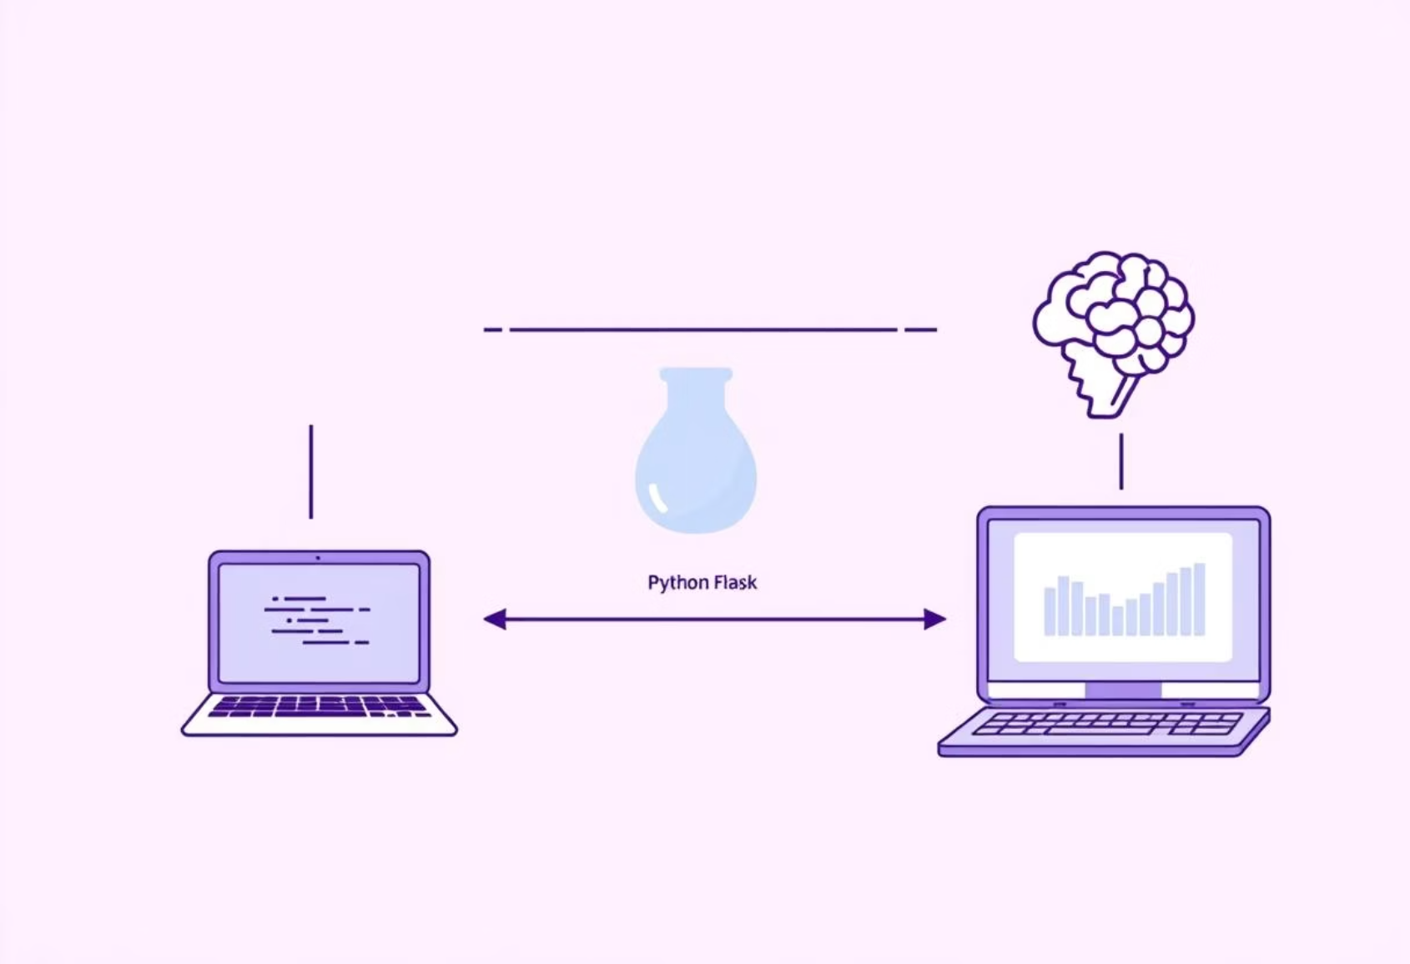
Proposed Solution & Architecture
Web-Based Predictive Tool
Solution Architecture
Allows manual input or JPG report upload for OCR-based data extraction. The ML model predicts cirrhosis stages and provides an easy-to-understand summary with medical suggestions.
Frontend: HTML, Tailwind CSS
Backend: Python, Flask
ML Model: Random Forest (scikit-learn)
Key Features
OCR: pytesseract, PIL
Instant prediction
Deployment: Render, GitHub
Cost-effective early assessment
Improved health awareness
Accessible via browser

Slide 7
Project Planning: Sprint Schedule
Sprint-1
Data Collection & Cleaning
Collect and preprocess dataset.
3
High
Sprint-1
Model Training
Train model for prediction.
3
High
Sprint-2
Flask Backend Integration
Build Flask backend.
3
High
Sprint-2
Frontend Interface
Create responsive UI.
2
High
Sprint-3
Prediction Explanation
Explain predicted stage.
1
Medium

Slide 8
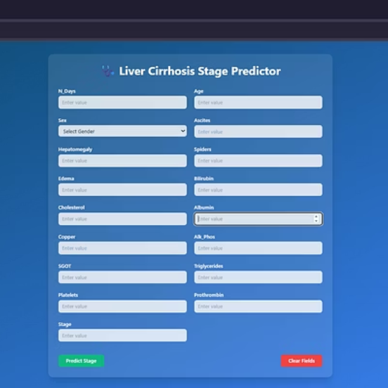
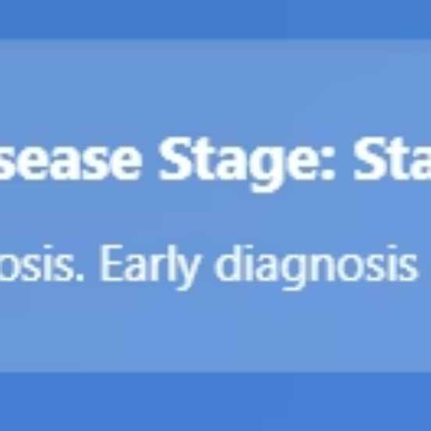
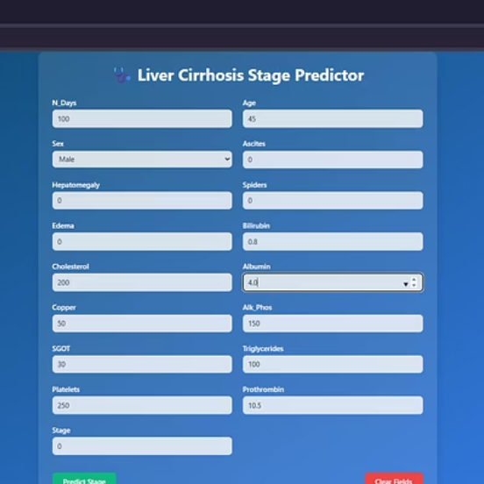
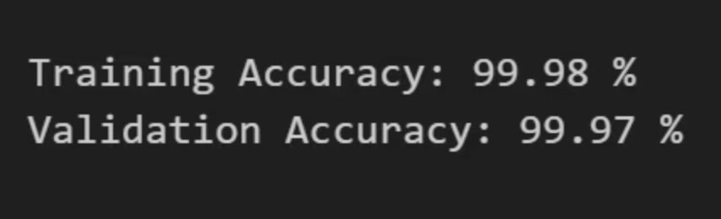
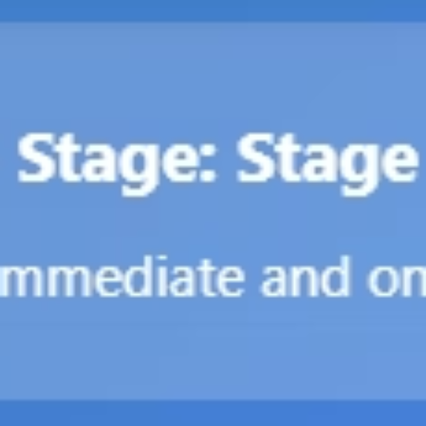
Performance Testing & Results
Model Accuracy
Web App Output
Random Forest: Training 99.98%, Validation 68%
The web app allows users to input data, click "Predict," and view the liver disease stage with a description.
KNN: 78.54%
XGBoost: 100.00%
Random Forest was selected for its stability and high performance.

Slide 9
Advantages & Disadvantages
Advantages
Disadvantages
Early Detection: Timely intervention, improved patient outcomes.
Numeric Input Only: Cannot interpret textual symptoms.
User-Friendly: Intuitive web interface.
OCR Limitations: May fail with poor quality reports.
Multi-Class Prediction: More informative for clinical decisions.
Dataset Limitation: Performance may vary on different populations.
Cost-Effective: Reduces need for expensive diagnostics.
High Performance: Reliable Random Forest model.
No Real-Time Integration: Standalone tool.
OCR Support: Enhances automation.
Security Concerns: Requires robust data privacy measures.

Slide 10
Conclusion & Future Scope
This project successfully integrates machine learning into medical diagnostics, offering a scalable and efficient tool for predicting liver cirrhosis stages. It enables timely treatment, resource optimization, and better patient outcomes.
Model Generalization
Train with larger, more diverse datasets.
Integration with EMRs
Enable automated, real-time predictions.
Mobile App Development
Increase accessibility, especially in rural areas.
Advanced Image Diagnosis
Incorporate medical imaging using deep learning.
Multi-Disease Detection
Expand to classify other liver diseases.

